Slide 1
What to watch today?
Prepared by Vladyslav Prosolupov,
Rostyslav Tryndyak,
German Varanytsya

Slide 2
Idea
The idea of our project is very simple, but the implementation is not so easy.
The main point of it is to help user to find a film to watch in free time.
It will work using algorithm based on data provided by client.
Also provide information about films (description, rating, etc.)/actors/directors.
Wikipedia for films with suggestions “just for you”.

Slide 3
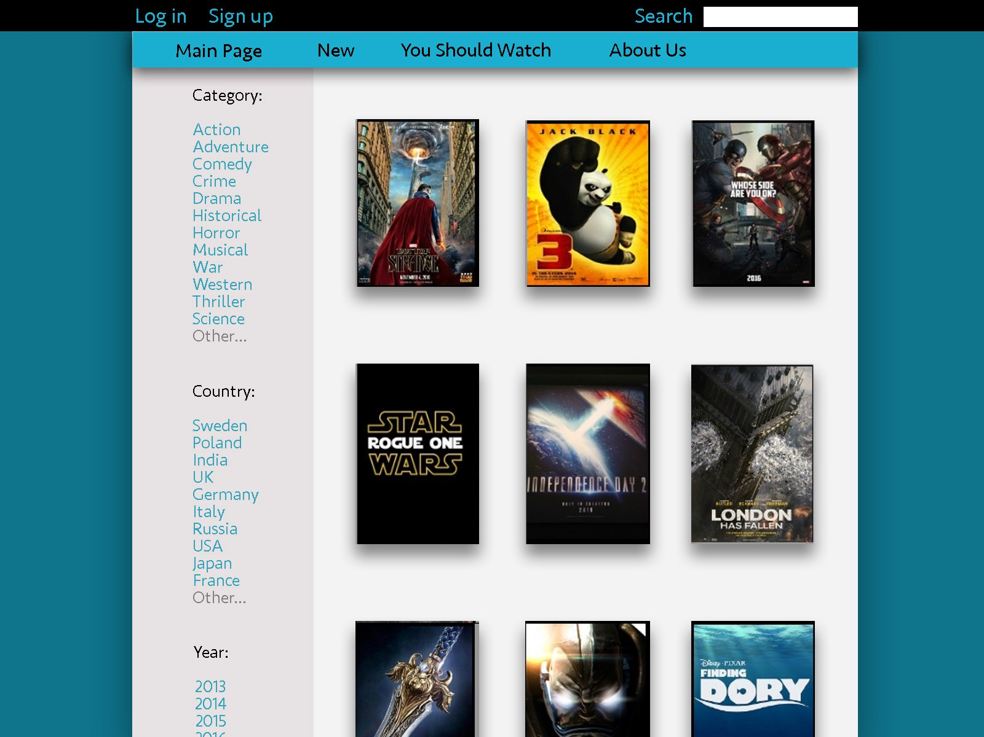
Design

Slide 4
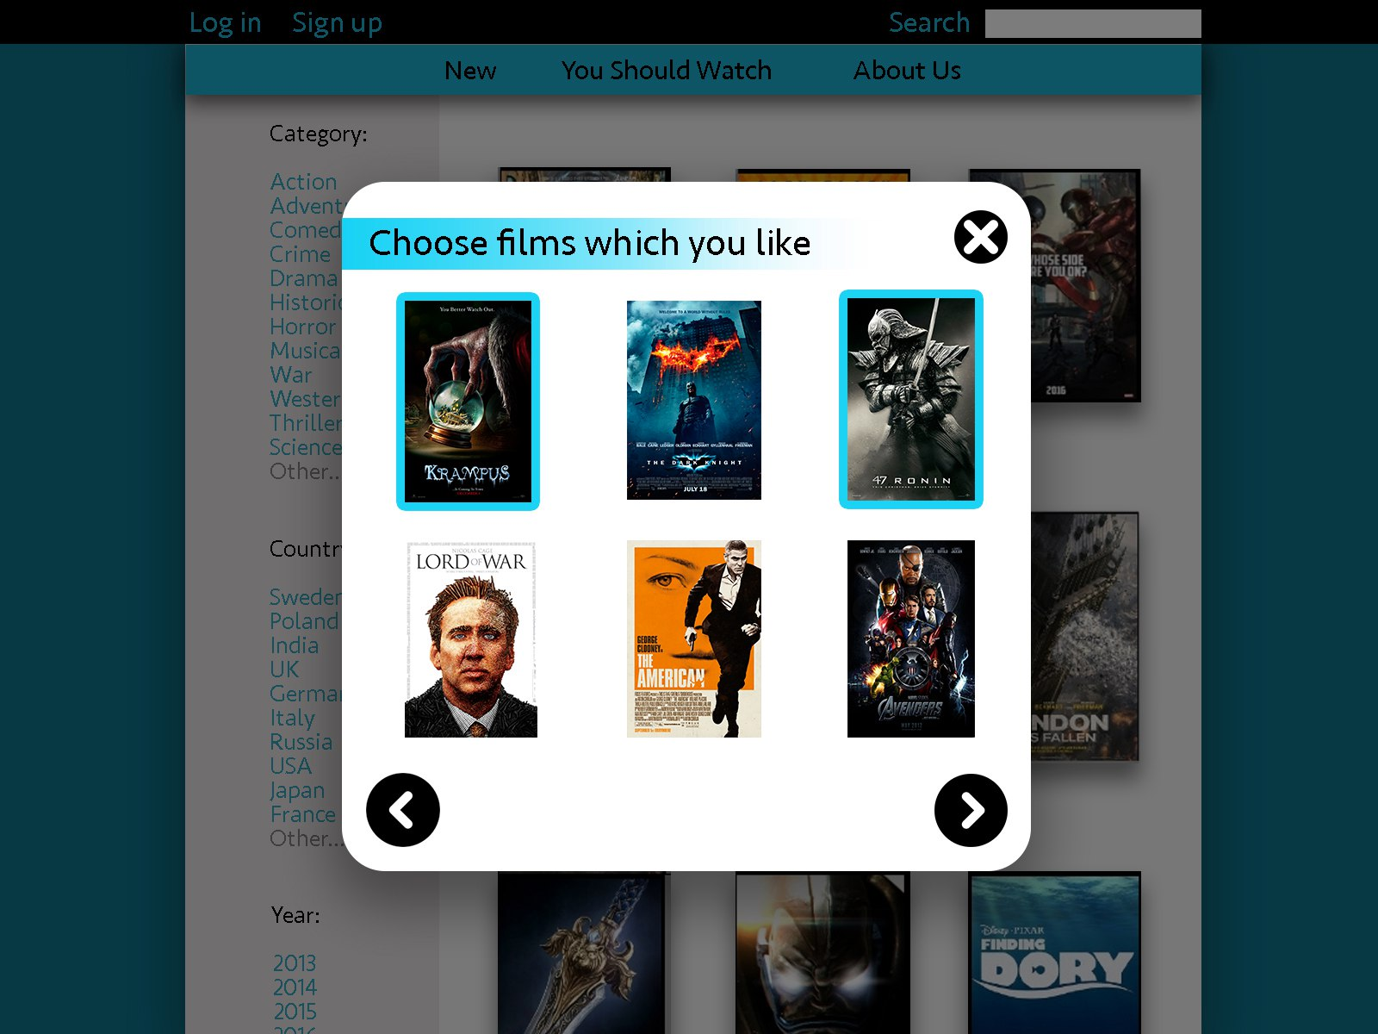
Design

Slide 5
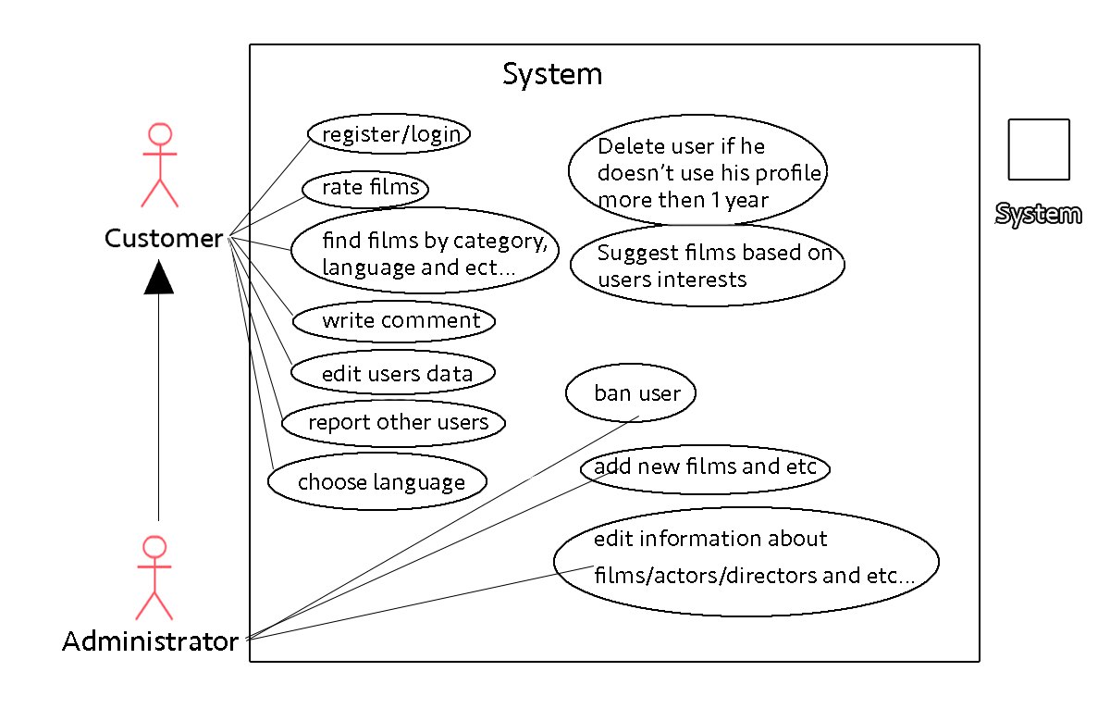
Use cases

Slide 6
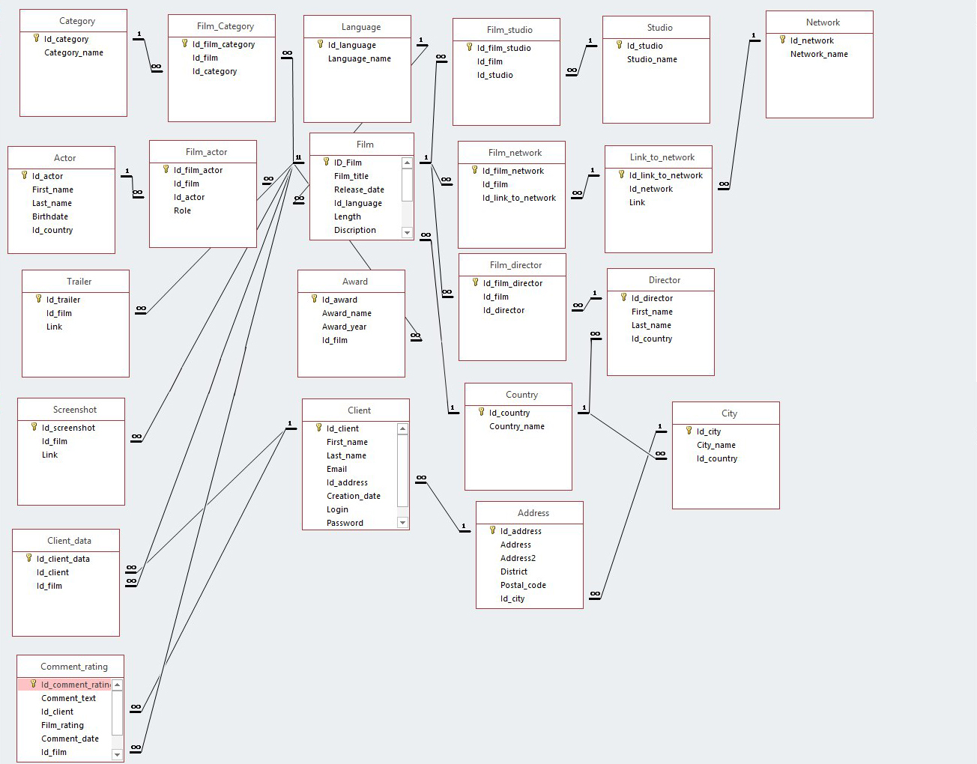
Entity diagram

Slide 7
Functional requirements
Sending confirmation email after registration/password changing/etc.
Registration of new users
Registration using outer social networks
Singing in already existing users
Search film by its name/year/director/etc.
Suggesting films basing on client-data
Editing client private data by client
Reporting users
Banning frequently reported users

Slide 8
Functional requirements
Leaving comment/rating to film
Marking comment/rating usefulness
Adding new categories/films/actors/directors/studios/networks to db by administrator
Editing categories/films/actors/directors/studios/networks by administrator
Limiting access (update/delete queries) to db to authorized users(administrators)
Reporting issues
Deleting accounts by users
Online support for users
Choosing language of the site for users

Slide 9
Thanks for your attention!

